Slide 1
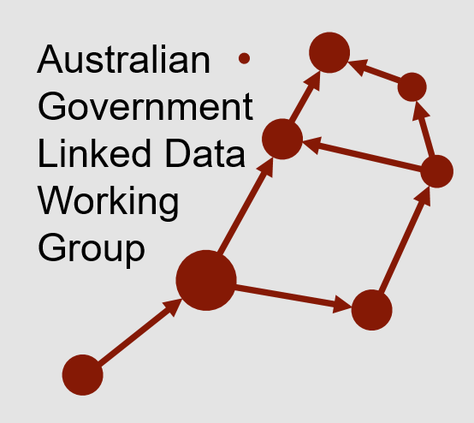

The Australian Case Study: Governance of Federal Data
Nicholas Car
Co-Chair AGLDWG, Senior Experimental Scientist, CSIRO

Slide 2
The Australian Case Study: Governance of Federal Data
˅
Federated
Nicholas Car
Co-Chair AGLDWG, Senior Experimental Scientist, CSIRO

Slide 3
About me – Nicholas Car
Currently a computer scientist based at CSIRO, Australia’s national scientific research agency
Currently co-chair of an informal govt. group involved with data sharing, the Australian Government Linked Data WG
Formerly Data Architect of Geosceince Australia – national geo science agency and a large data publisher
Working on national data sharing systems and fundamental government datasets

Slide 4














Australian Government Linked Data WG
Aust. Gov. experts and champions for Linked Data
Informal body, formal participation of members
Established 2012
Recent membership growth due to govt. policy interest
Operates with an MoU between agencies

Slide 5
Outline
Australian data landscape
Distributed data production
Producing data independently with individual authority
Interoperability
Allowing data to interoperate with other independently-produced government data
Data harmonisation & integrity
Reducing the effort required for data harmonising for use while still maintaining data integrity
Summary of aims for industry

Slide 6

Australian data landscape
National Innovation & Science Agenda (2015) - $1.1B f
backing entrepreneurs’ use of public research
increasing industry/research collaboration
developing and attracting world-class talent
Australian Government leading by example; embracing innovation and agility in business
https://www.industry.gov.au/strategies-for-the-future/boosting-innovation-and-science

Slide 7
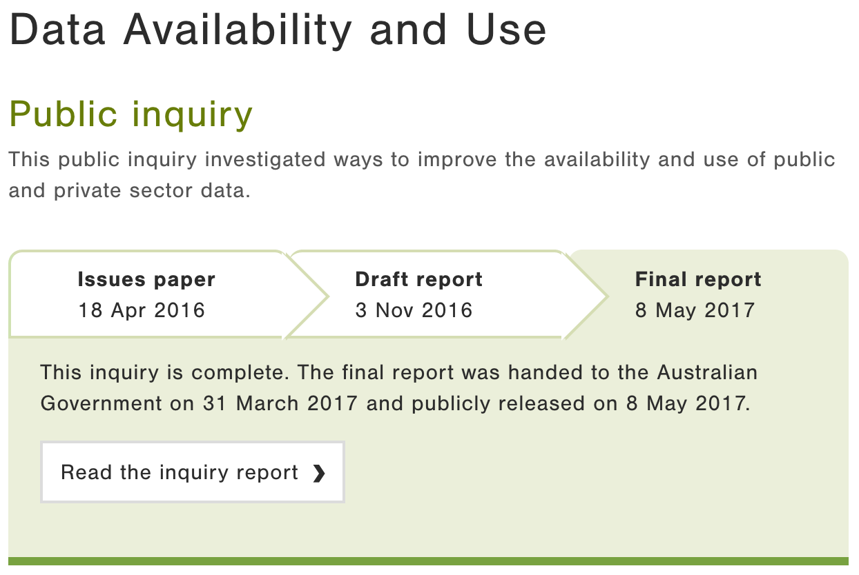
Australian data landscape
Data Availability & Use (2017)
benefits & costs of making Gov. data more available
options for collection, sharing and release of data
identified ways consumers could use & benefit from access to data, particularly data about themselves
considered individual privacy & control over data
https://www.pc.gov.au/inquiries/ completed/data-access#report

Slide 8

Australian data landscape
Digital Transformation Agency (2017)
“We exist to make it easy for people to deal with government. We help government transform services to be simple, clear and fast.”
https://www.dta.gov.au

Slide 9

Australian data landscape
National Data Commissioner (2018)
“implementing a simpler data sharing and release framework”
https://www.datacommissioner.gov.au

Slide 10
Outline
Australian data landscape
Distributed data production
Producing data independently with individual authority
Interoperability
Allowing data to interoperate with other independently-produced government data
Data harmonisation & integrity
Reducing the effort required for data harmonising for use while still maintaining data integrity
Summary of aims for industry

Slide 11
Distributed data production
Producing data independently with individual authority
Why this is necessary?
Current work
Case study

Slide 12
Distributed data production
Why this is necessary?
Agencies can’t work together – jurisdictional & technical reasons
Even if willing, noone knows all data initiatives
Agencies will not, and should not, cede authority to others
Authority carries trust
Huge efforts made to ensure data in hand is authoritative
Direct publication makes this easier

Slide 13

Distributed data production
Current work
National Data Commissioner, Accredited Data Authorities
“hubs of expertise to enable other datasets of public interest to be linked, shared or released”
National Interest Datasets – example, G-NAF
Demonstrator projects
MADIP & Blade
‘Spines’

Slide 14
Distributed data production
Case study – LOC-I
One of the ‘spines’

Slide 15
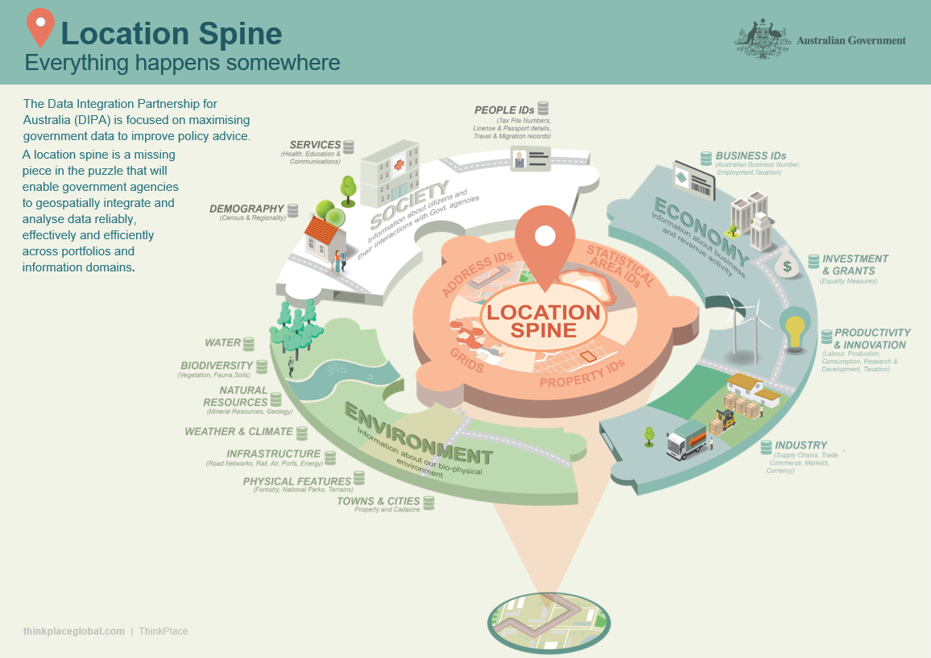
https://confluence.csiro.au/display/DIPAAnalyticHubs/Project+Overview

Slide 16
Distributed data production
Case study – LOC-I
Distributed generation & publication of national spatial datasets, different agencies
Geocoded addresses - buyout
Digital elevation model & water - previous work
Statistical geographies - current work
Integration – current work
Interoperability - technical, next
Access - mostly public, doesn’t have to be

Slide 17
Outline
Australian data landscape
Distributed data production
Producing data independently with individual authority
Interoperability
Allowing data to interoperate with other independently-produced government data
Data harmonisation & integrity
Reducing the effort required for data harmonising for use while still maintaining data integrity
Summary of aims for industry

Slide 18
Interoperability
Allowing data to interoperate with other independently-produced government data

Slide 19
Interoperability
Allowing data to interoperate with other independently-produced government data
…and indicate how the private sector may too!

Slide 20
Interoperability
Interoperability principles
Persistent identity
Managed identifiers for dataset, elements within them and lookup values
Long-term stable, regardless of tech or org changes
linked.data.gov.au – the dedicated, persistent govt. identifier domain
http://linked.data.gov.au/dataset/gnaf/address/GAACT714845933 - a specific address identifier
http://linked.data.gov.au/def/reg-status/submitted - the term ‘submitted’ within a vocabulary

Slide 21
Interoperability
Interoperability principles
Persistent Identity
Formal modelling paradigms
Model ‘anything’ with a formal semantics
Create overarching models
Create detailed, nested models
LOC-I model & individual dataset models

Slide 22
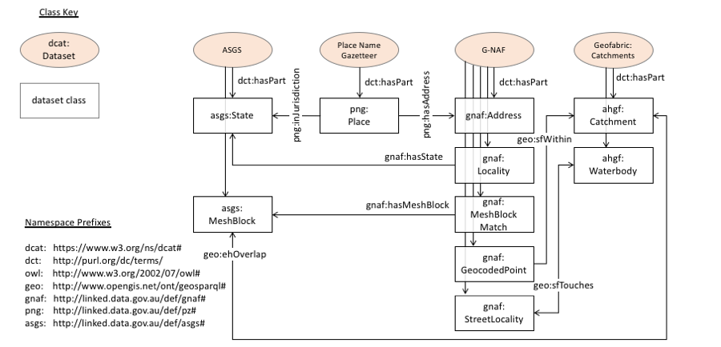
Interoperability
Interoperability principles
Persistent Identity
Formal modelling paradigms
Model ‘anything’ with a formal semantics
Create overarching models
Create detailed, nested models
LOC-I model & individual dataset models

Slide 23
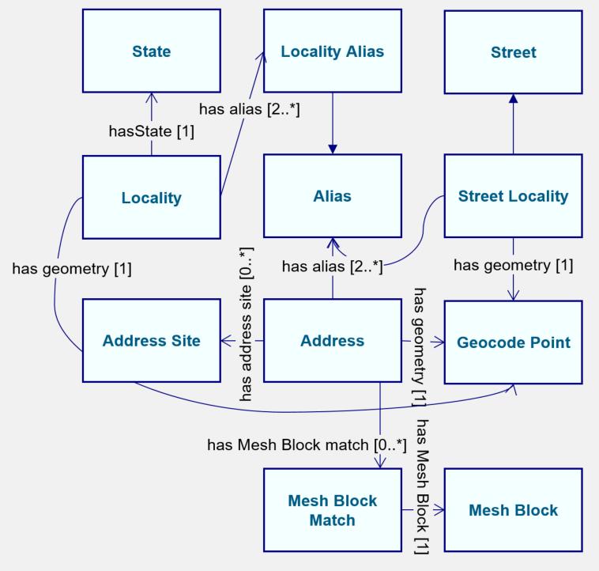
Interoperability
Interoperability principles
Persistent Identity
Formal modelling paradigms
Model ‘anything’ with a formal semantics
Create overarching models
Create detailed, nested models
LOC-I model & individual dataset models
G-NAF

Slide 24
Interoperability
Interoperability principles
Persistent Identity
Formal modelling paradigms
Reference metadata
- Person
- Pensioner - Student - Worker
Different dataset, the same terms used

Slide 25
Interoperability
Interoperability principles
Persistent Identity
Formal modelling paradigms
Reference metadata
Reference data
LOC-I and other ‘spines’

Slide 26
Interoperability
Interoperability principles
Persistent Identity
Formal modelling paradigms
Reference metadata
Reference data
Case study: Longitudinal Spine of Government Functions

Slide 27
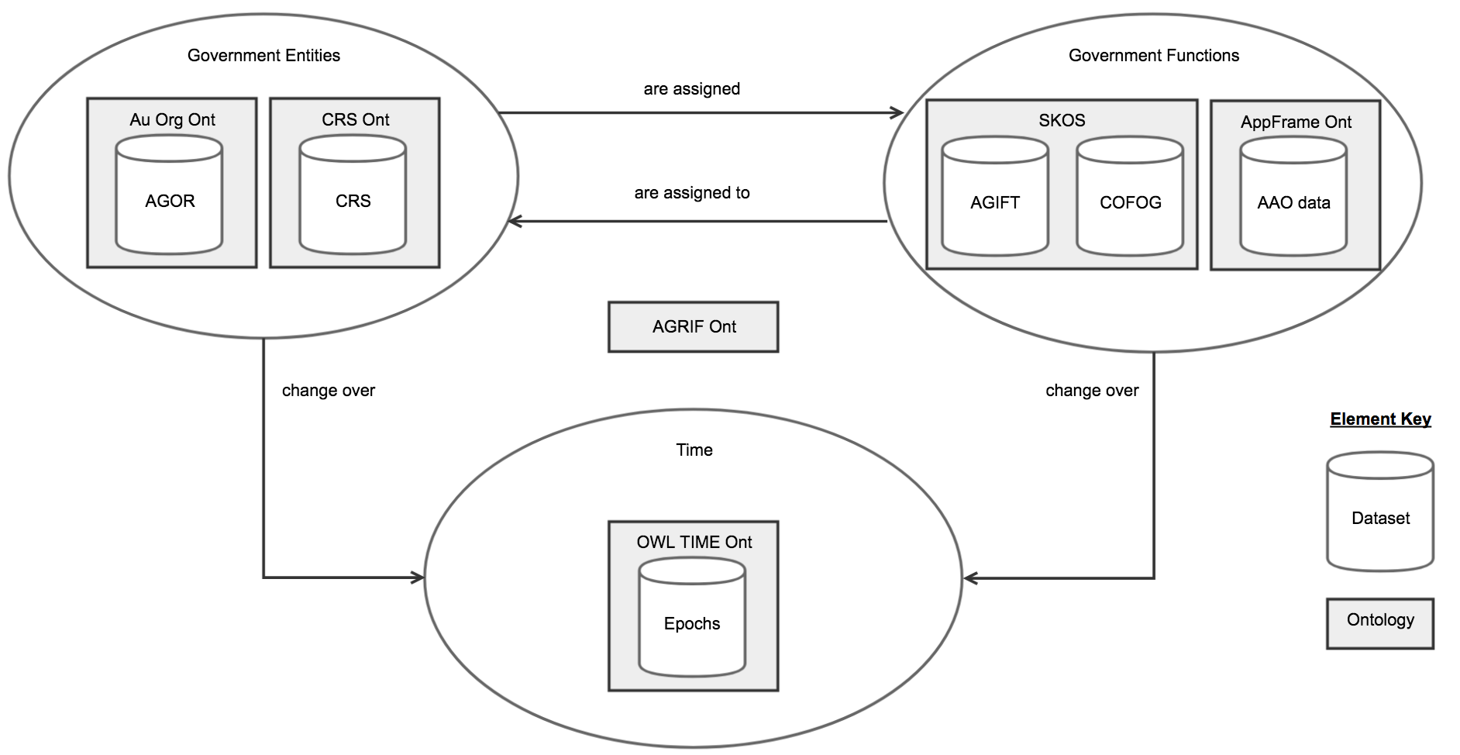
Interoperability
Case study: Longitudinal Spine of
Government Functions
Interoperability principles
Persistent Identity - linked.data.gov.au used
Formal modelling paradigms - Web Ontology Language
Reference metadata - Functions vocabularies
Reference data - Time epochs, govt. orgs.
Case study: Longitudinal Spine of Government Functions

Slide 28
Interoperability
Interoperability principles
Persistent Identity - linked.data.gov.au used
Formal modelling paradigms - Web Ontology Language
Reference metadata - Functions vocabularies
Reference data - Time epochs, govt. orgs.
Case study: Longitudinal Spine of Government Functions

Slide 29
Outline
Australian data landscape
Distributed data production
Producing data independently with individual authority
Interoperability
Allowing data to interoperate with other independently-produced government data
Data harmonisation & integrity
Reducing the effort required for data harmonising for use while still maintaining data integrity
Summary of aims for industry

Slide 30
Data harmonization & integrity
Reducing the effort required for data harmonising for use while still maintaining data integrity
Proportionate phases of data use
Discover
Access
Prepare
Use

Slide 31
Data harmonization & integrity
Harmonization
Data with persistent identity & formal semantics
is better than
Locally identified, semi-structured, ill-defined data
Is not a huge proportionate impost on large datasets’ production
Can be a one-time task
Reference datasets & data
Is a national responsibility
Requires coordination & discipline
With harmonisation Preparation is easy…

Slide 32
Data harmonization & integrity
Integrity
Indicated by
Nominating Accredited Data Authorities
Use of national identifiers
Preserved by
Allowing distributed publication
Oversight of publication methods & standards
National Data Commissioner
Digital Transformation Agency
Linked Data WG
Data quality a matter for individual jurisdictions
Checked by
Projects that demonstrate distributed data use
Data validators*

Slide 33
Aust Govt Integrated Set of Ontologies (AGISO)
CSIRO is developing tools to
Publish models and collections of them for reuse
Validate detailed models’ adherence to overarching models
Validate data’s adherence to models
CSIRO involved in web standards – W3C – and tools for Web Ontology Language content validation

Slide 34
AGISO cont. – LOC-I
First implementation test in LOC-I project
path association
path association ← via spatial & AGISO associations
Govt. Org Data
Business Data
Enviro Data
spatial association
spatial association
spatial association
Geofabric
G-NAF
Adm Bnds
AGISO spatial datasets
AGISO association

Slide 35
Outline
Australian data landscape
Distributed data production
Producing data independently with individual authority
Interoperability
Allowing data to interoperate with other independently-produced government data
Data harmonisation & integrity
Reducing the effort required for data harmonising for use while still maintaining data integrity
Summary of aims for industry

Slide 36
Summary of aims for industry
Government data should be
Easier to harmonize and thus use
Trusted due to authority retained
Indicates how industry could/should operate
Able to be used in non-open systems

Slide 37
Questions?
Contacts
AGLDWG: http://linked.data.gov.au
Nicholas: nicholas.car@csiro.au

